Slide 1
Qualifier Instructions & Tools
Reference: Qualifier Calibration calls
September 29, 2015 (AP)
October 1, 2015 (NA/EULA)
November 5, 2015 - Revision 1.0
For questions or comments, please contact Sarah Escosa
Notes:
Instructor Notes

Slide 2
Content
Intended for Qualifiers to support candidate Lead Auditors
  Lead Auditor Oversight Records (Quality Engineering Website)
  Process Changes
  Responsibilities
  Steps commonly forgotten
  Q&A from Qualifiers
  Tools to Help Support Candidates
  Contacts
Slide <number>

Slide 3

Access/Update Lead Auditor Oversight Records
Instructions
(October 9, 2015 email from DAP Performance Manager)
Reminders:
Fill out form as each stage is completed since a different Qualifier may support candidate at the next stage.
Refresh the page (F5 or Ctrl+R) after uploading updated form. It is there, but the browser typically shows the previous version.
Slide <number>

Slide 4
Process Changes
Requalification oversights require decision, at least 1 month before audit visit, if candidate can conduct onsite audit independently or not.
Multiple Qualifiers may support 1 candidate (different Qualifier per stage).
Qualifier’s signature is final approval (no manager approval).
Qualifier’s travel expense covered by candidate’s industry.
ePro similar profile for Qualifier is no longer required (optional).
Slide <number>

Slide 5
Process Changes (since calibration call)
Qualifier must be identified as part of audit team IF supporting:
  new candidate not currently qualified in Technical Competency database, or
  onsite audit for currently qualified LA completing Requalification oversight
  Audit reports & ePro must match:
Role | Identified As:
Qualifier | “Lead Auditor”
Candidate | “Auditor”
Slide <number>
Notes:
1. When supporting a new candidate, the Qualifier is ultimately responsible for the audit project and needs to be on record.
2. If the Qualifier is onsite for a Requalification oversight, he/she is identified in Areport as part of the audit team so the record must match in ePro.

Slide 6
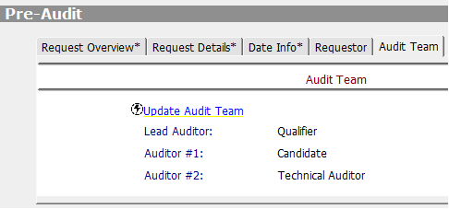
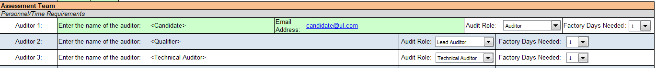
Process Changes (since calibration call)
ePro:
DAP Assessment Tool, “DAP Tool Preparation” page:
Slide <number>
Notes:
1. When supporting a new candidate, the Qualifier is ultimately responsible for the audit project and needs to be on record.
2. If the Qualifier is onsite for a Requalification oversight, he/she is identified in Areport as part of the audit team so the record must match in ePro.

Slide 7

Responsibilities
Steps commonly forgotten. Remember to:
Pre-Audit:
Immediately communicate how and when you are available to help.
Gauge LA’s understanding of ALL applicable requirements, not only those selected for audit assigned.
Post-Audit:
Conduct pre-review, discuss, revise any errors found before sending to client and posting for review.
Discuss Reviewer’s comments after PR and FR.
Review how LA writes NCRs and assesses client responses (even if none were issued).
Sign completed form with date on or after LA’s project is through FR.
Slide <number>
Notes:
Use the word document to guide your steps at each stage (pre, onsite, post audit).

Slide 8
Q & A from Qualifiers
  Q: How do we make sure the candidate knows there are different ways to conform to a requirement, not just one. They can read and understand the clause but how to does it apply to THIS client?
  A: Help the LA pre-audit by discussing the “intent” of each clause and how to gather evidence to determine if the client’s “system” meets it. (See “Qualifier Responsibilities” Pre-Audit, Step 5)
  Q: How do we serve as a Qualifier for a candidate:
      In a different office.
      In a different time zone.
      When we have to use English and it is not my main language.
      Who is not from CAS/Engineering and unfamiliar with ePro or eComm.
A: Try communicating with conference call, Lync chat, email, or share desktop to show work. Schedule enough time to discuss/revise tool work to meet assessment timeline. Ask questions in different ways to ensure candidate’s consistent understanding.
Slide <number>
Notes:
The questions above were identified by various Qualifiers prior to our regional calibration calls.
We discussed best practices as a group to help staff in these situations.

Slide 9
Q & A from Qualifiers (continued)
  Q: What can we do when we learn the candidate’s workload is high?
  A: It is critical to have a talk up front to discuss expectations and agree on scheduled target dates. Communicate to them (manager if needed), that they were nominated by industry leads to serve as a Lead Auditor and to dedicate the required time to complete the full learning/oversight process. If the candidate is repeatedly falling behind on tasks and not learning the skills, provide a detailed evaluation on the oversight form and let us know (see “Contacts” slide). We are here to support you.
  Q: When do we consider a candidate to be qualified?
A: When the candidate can independently and effectively demonstrate all the skills on the oversight form after your mentoring. The candidate should also feel confident in their skills. Ask them how they feel throughout the process. They could fill out the oversight form to give you a better idea of their strengths and weaknesses.
Slide <number>

Slide 10
Tools to Help Support Candidates
  Link to Qualifier Calibration Call (October 2015)
  Hints: Link opens in presentation mode, use Chrome (download progress shows), Internet Explorer is idle until Windows Media Player starts video.
  These Qualifiers received positive feedback on their individualized tools for processing audits and supporting candidates. Contact them to share materials with you:
  Duncan Li (Taiwan):
    GAP assessment for candidate to identify areas of strength vs areas that need mentoring
  Kenneth Berger (USA):
    DAP Audit Process for Lead Auditor, Technical Auditor and Client with target dates
    Technical Auditor Process
    Exam to evaluate candidate knowledge on requirements and use of tools
  Philippe Salle (France):
    Checklist to make sure report (DAP Assessment Tool) and DAP Scope Form database are completed correctly before posted for review.
Slide <number>

Slide 11
Contacts
THANK YOU
Cheryl Adams
DAP Performance Manager.
Larisa Aoyagi
DAP Regional Manager (AP & EULA), audit assignment, works with regional industry leads.
Linda Ziemnick
DAP Regional Manager (NA), audit assignment, works with regional industry leads.
Sarah Escosa
  Qualifier assignment, manage all oversights (new & requalification),.
Slide <number>

